Slide 1
Is the FED Maintaining its Dual Mandate?

Slide 2
Overview
The Federal Reserve (FED) is responsible for
Maintaining interest rates
Regulating banking
Establishing monetary policy
The primary role of the FED, established in 1970, is to uphold the Dual Mandate, which requires the FED aim to:
Maximize employment
Stabilize inflation rates
Notes:
Source: https://onlinemba.wsu.edu/blog/the-roles-and-responsibilities-of-the-federal-reserve

Slide 3
Inflation
Defined as “the rate of increase in prices over a given time”
Necessary, in moderation, for a healthy economy
However, unchecked inflation can result in negative consequences for consumers and businesses
Loss of purchasing power
Poor economic growth
Typically, an inflation rate of 2% is considered ideal
Inflation can be quantified via the Consumer Price Index (CPI)
Measure of the changes in price of consumer goods over time
Notes:
https://www.imf.org/en/Publications/fandd/issues/Series/Back-to-Basics/Inflation#:~:text=Inflation%20is%20the%20rate%20of,of%20living%20in%20a%20country.

Slide 4
Employment
Defined by the amount of individuals, aged 15-64 are part of the U.S. labor force
I.e., Individuals who are fully employed
An important indicator of economic health
Typically measured via unemployment rates
I.e., The proportion of individuals who are not employed or active in the labor force
Notes:
Source: https://www.oecd.org/en/data/indicators/employment-rate.html

Slide 5
What can the FED do to Uphold the Dual Mandate?
To support the Dual Mandate, the FED can adjust their funds rates (or in other words, interest rates) according to macro-economic necessities
Raising interest rates discourages banks from taking out loans
Lowering interest rates encourages banks to take loans and invest

Slide 6
What can the FED do to Uphold the Dual Mandate?
To summarize the impact of interest rate adjustments:
Interest rates are typically increased to limit economic growth
Goal: To reduce inflation rates
Interest rates are typically decreased to encourage economic growth
Goal: To reduce unemployment rates
Notes:
Source: https://fred.stlouisfed.org/series/FEDFUNDS

Slide 7
Primary Question
With all of this in mind, it generates the question:
Is the FED fulfilling its obligation to control inflation while simultaneously limiting unemployment?
To explore this question, let us visualize how these indicators have changed together over time

Slide 8
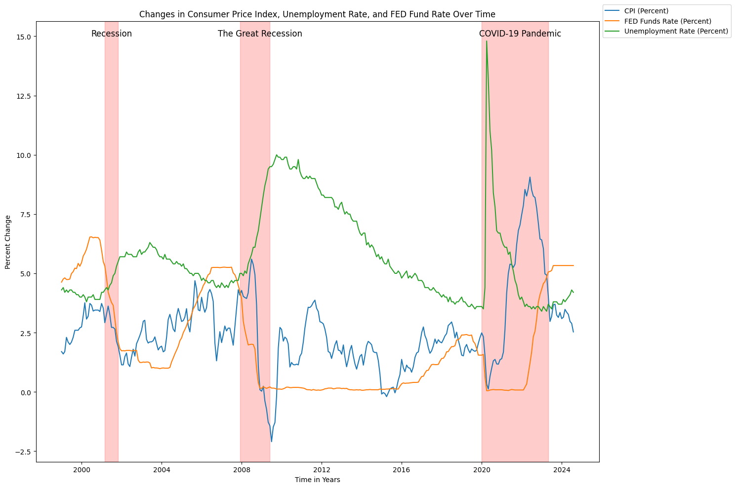
Interpretations:
FED Fund rates:
Decrease during periods of economic instability
Stabilize or increase during periods of economic stability
Recession periods have a major impact on unemployment and CPI
FED can only hope to control the damage, but it seems to take time for the effects of adjustments to manifest

Slide 9
Taking a Closer Look at CPI
Now that we have seen the changes in these indicators together, we can examine them separately
Next, we will look at changes in CPI rates and how they correspond with FED fund rate changes
We will gauge economic health based on whether CPI is being maintained around the 2% mark
It is commonly agreed that a 2% inflation rate is considered ideal or healthy
So inflation rates markedly above or below 2% may be indicative of poor economic health
Notes:
Source: https://www.federalreserve.gov/faqs/economy_14400.htm

Slide 10
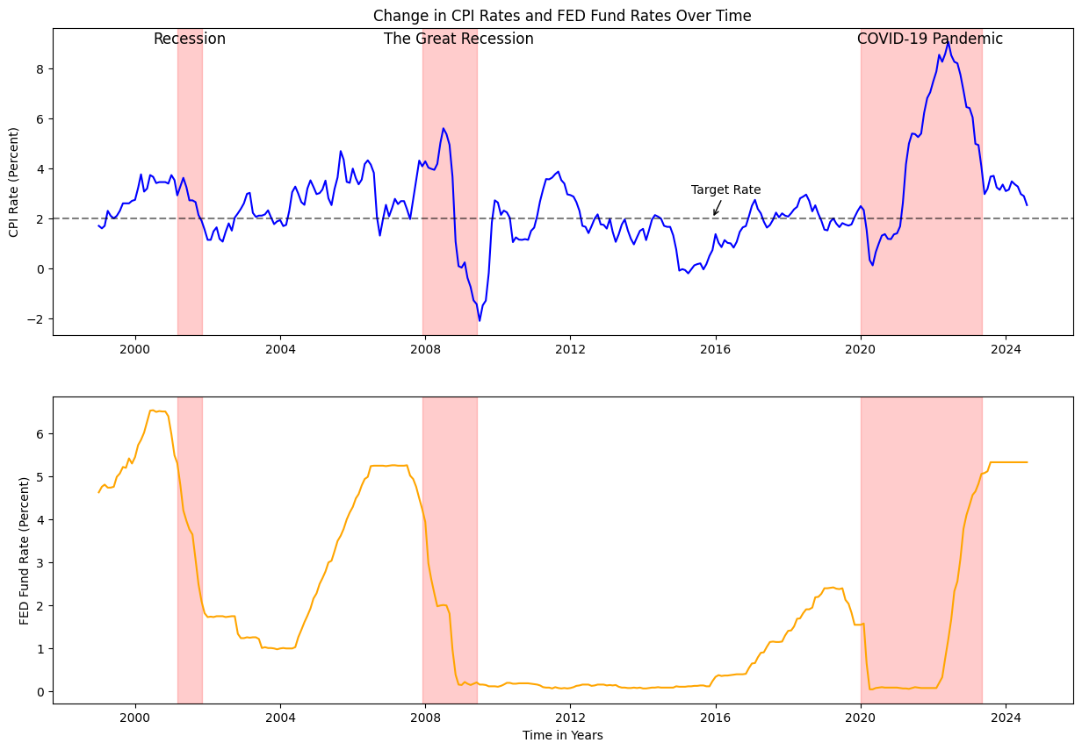
Interpretations:
CPI tends to stay around the 2% mark during periods of stability
Typically decreases in response to recession periods
Exception being the COVID Pandemic
FED increases interest rates when CPI gets too high
FED Lowers interest rates when CPI gets too low

Slide 11
Taking a Closer Look at Unemployment
Now we can apply the same type of visualization for unemployment rates and FED fund rates
While the FED does not have a formally defined target for unemployment rates, we will gauge economic health based on whether unemployment rates are maintained within the range of 3% to 5%
With this in mind, we can consider ranges above 5% to be unhealthy, as this indicates a large proportion of individuals not receiving an income. A rate below 3% may indicate a coming increase in inflation
Notes:
Source: https://www.forbes.com/advisor/personal-finance/unemployment-rates-by-city/#:~:text=A%20reasonable%20unemployment%20rate%20is,the%20economy%20as%20a%20whole.

Slide 12
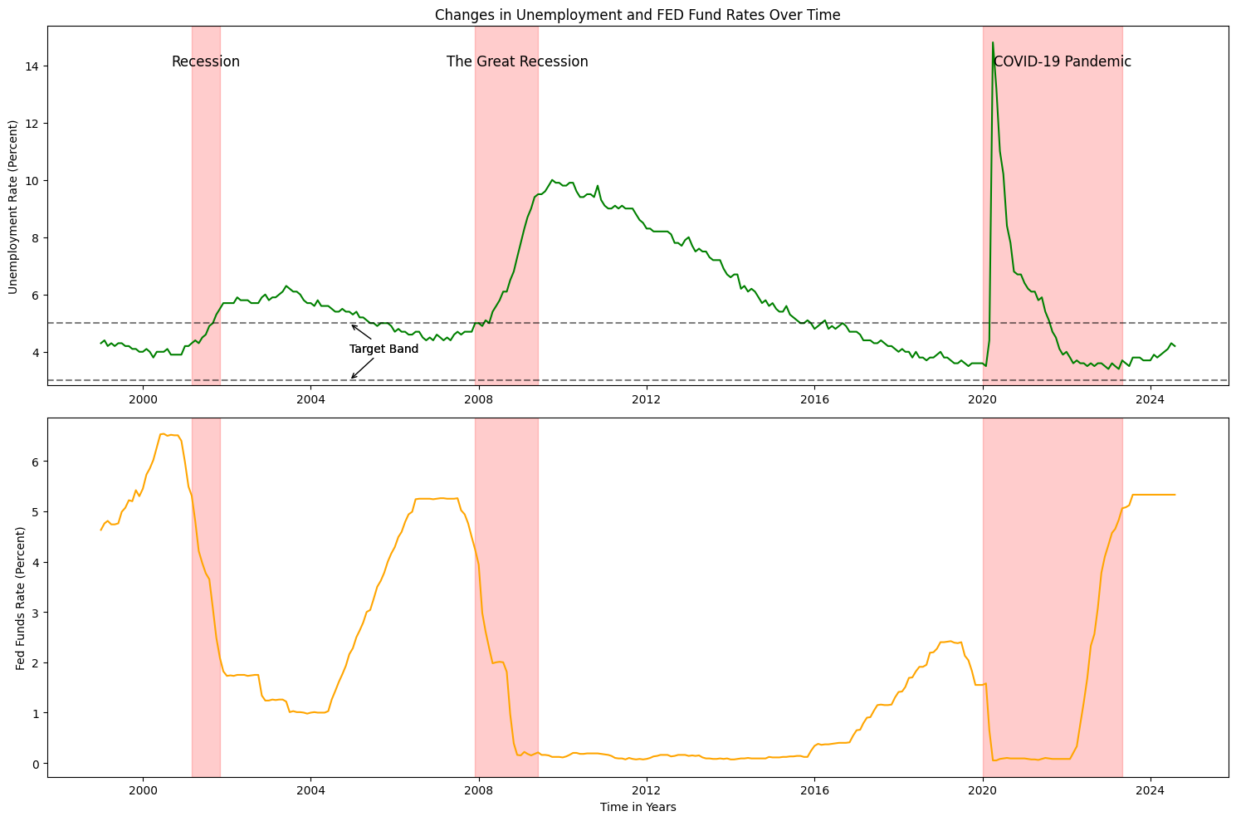
Interpretations:
Unemployment tends to stay above the 5% mark
Sharply increases as a result of recessions
FED tends to lower interest rates during recession to compensate for the low economic health
Effects manifest some time after rate cuts

Slide 13
Misery Index
Now that we have examined changes in FED Fund rates, CPI rates, and unemployment rates, one final analysis we can perform is the impact of FED fund rate adjustments on the Misery Index
The Misery Index is defined as an indication of deteriorating economic health based on combined (additive) CPI and unemployment rates
We will consider a target range for the Misery Index to be around 5% - 6%, based on adding the target ranges for inflation and unemployment rates
Notes:
Source: https://www.miseryindex.us/

Slide 14
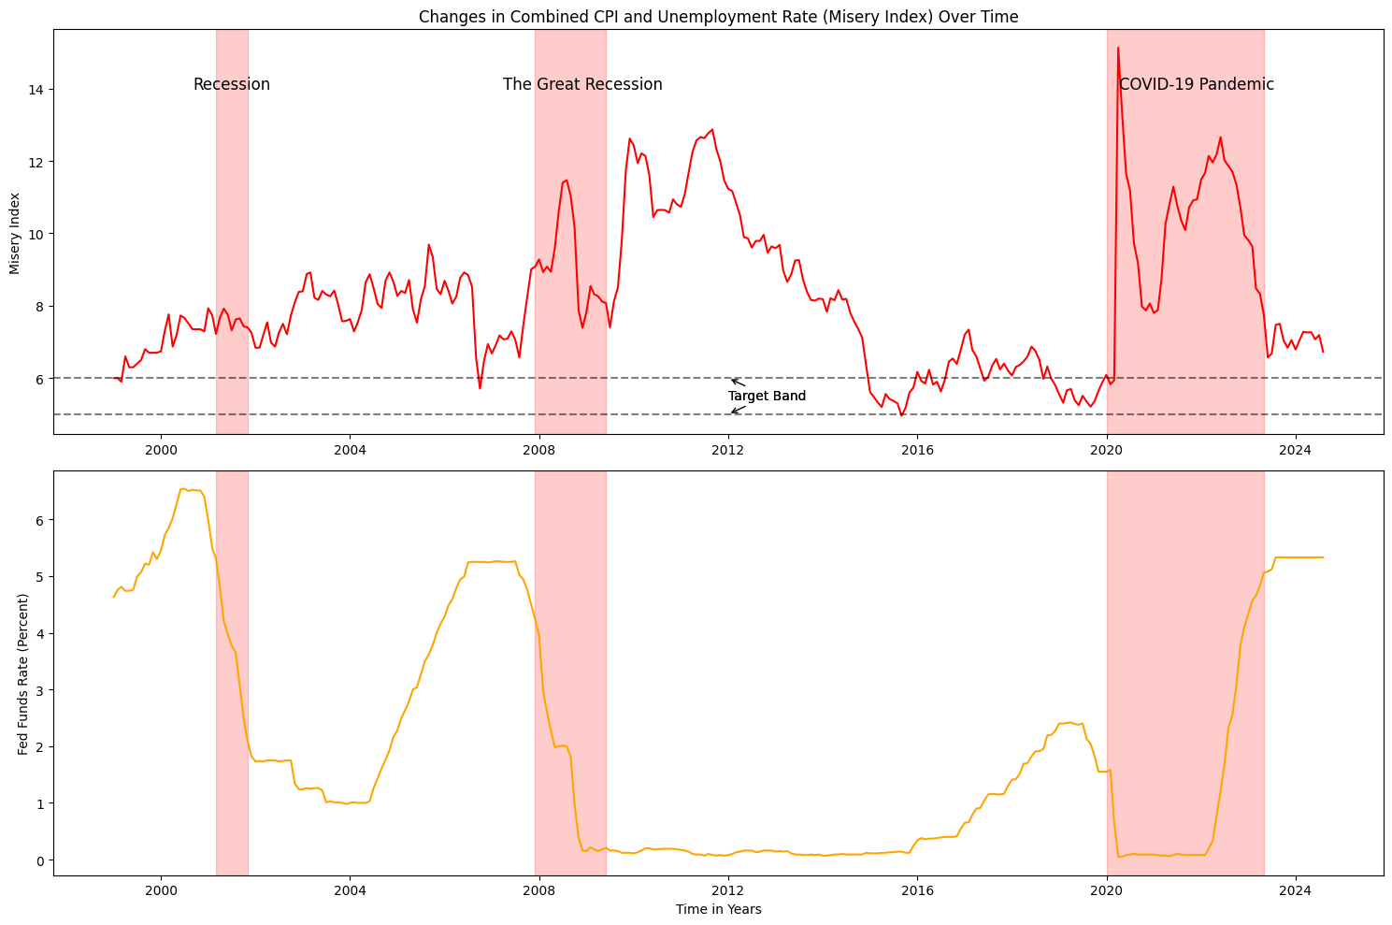
Interpretation:
The Misery Index tends to stay above our predefined target bands, even outside of recession periods.
This is likely due to the weight of unemployment rates on this index
Changes in FED fund rates appear inconsistent with changes in the Misery Index
although there may be more of a tendency for increases in FED fund rates to correspond with decreases in the Misery Index

Slide 15
Conclusions
Question: Is the FED upholding the dual mandate
Answer: It is complicated!
CPI appears to be the most controlled indicator overall
Unemployment tends to remain high, even during extended rate cut periods; however, unemployment tends to decrease to stable levels eventually (until the presence of a recession or pandemic, that is)
Based on the misery index, it seems that overall economic health is perilous
Index remains above 6% consistently
However, we are now in a period of recovery

Slide 16
Conclusions
Overall, the FED is doing its upmost to maintain stable levels of inflation and unemployment
However, the presence of economic downturns complicate the FED’s role
Difficulties regarding balancing the need to spur economic growth and stymie unchecked inflation
Decreases in unemployment rates tend to lag far behind rate cuts
Of course, FED decisions play only a partial role in U.S. macro-economic health
More research is needed to determine other factors that influence CPI and unemployment

